Slide 1


EDA Project on fifa data

Slide 2
About Me : I am pursuing 3rd Year Btech in Computer Science And Business System in G Pulla Reddy Engineering College, Kurnool. I am working Data Science intern at InternX. Experience : I am currently doing my internship on Data Analysis and Machine Learning , gaining valuable hands experience and insights into real world applications of these technologies.
www.linkedin.com/in/veeraboyini-golla-mohanandu-ok
github.com/Mohanandu

Slide 3
Agenda :
Objective
Data Description
Data Cleaning
Data Analysis and visualization
Conclusion

Slide 4
Objective :
During this data analysis, I had a few objectives to complete.
The instructions were to create your a football club using the following guidelines:
My club doesn't have a team yet.
The team will need to hire players for the roster.
I must select the players using a data based approach.
I have to create a report to recommend 14-16 players for the roster.
Assume a budget for hiring players to be limited.
The report has to help management/stakeholders in decision making.

Slide 5
Data Description :
ID: Unique identifier for each player.
Name: The player's full name.
Age: The player's age in years.
Nationality: The country the player represents.
Overall: The player's overall rating.
Potential: The player's potential rating.
Club: The club the player is currently playing for.
Value: The market value of the player.
Preferred Foot: The foot the player prefers to use.
International Reputation: The player's reputation on the international stage (1-5 scale).
Weak Foot: The player's proficiency with their non-preferred foot (1-5 scale).
Skill Moves: The player's ability to perform skill moves (1-5 scale).
Work Rate: The player's work rate in attack and defense.
Body Type: The player's body build.
Real Face: Whether the player's face is a real likeness in the game.
Position: The player's primary playing position.
Jersey Number: The player's jersey number.

Slide 6
Data Description
Long Shots: Accuracy of long-distance shots.
Aggression: Aggressiveness in play.
Interceptions: Ability to intercept passes.
Positioning: Tactical positioning.
Vision: Ability to see and make passes.
Penalties: Accuracy of penalty shots.
Composure: Ability to remain calm under pressure.
Marking: Ability to mark opponents.
Standing Tackle: Ability to tackle while standing.
Sliding Tackle: Ability to tackle while sliding.
GK Diving: Goalkeeper's diving ability.
GK Handling: Goalkeeper's handling ability.
GK Kicking: Goalkeeper's kicking ability.
GK Positioning: Goalkeeper's positioning ability.
GK Reflexes: Goalkeeper's reflexes.
Acceleration: Quickness off the mark.
Sprint Speed: Top sprinting speed.
Agility: Ability to move quickly and easily.
Reactions: Responsiveness to events.
Balance: Stability and balance.

Slide 7
Data Cleaning :
I first removed the Loaned From column and players with no club. I assumed these to be irrelevant with little effect to the crucial data needed to form the best club within a reasonable budget.
I cleaned the Value, Wage, and Release Clause columns to remove the euro symbol as well as any existing "K" and "M" in the cells indicating thousands or millions.
Then, I converted the value type to a float.
Continuing this, I dropped any players that had nothing in the Value column, as these entries would be crucial to forming the team.
I changed the height from feet and feet into inches. Though this was not necessary for my analysis, I decided to standardize the formatting of all cells. Similarly, I removed the "lbs" from all cells in the Weight column.

Slide 8
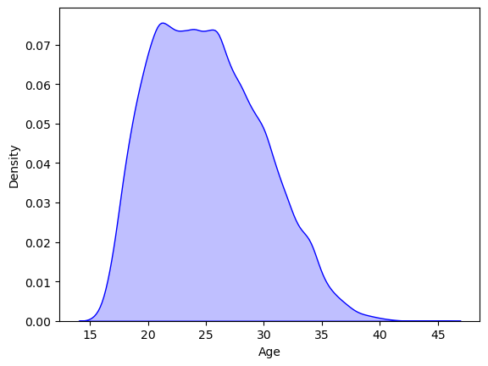
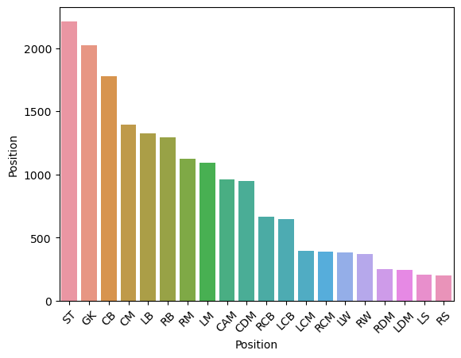
Data Analysis and Visualization :
The plot shows that the majority of players are between the ages of 20 and 30, with a peak around age 25.
The bar chart indicates that the most common player positions are Striker (ST) and Goalkeeper (GK), with Striker being the most frequent.

Slide 9
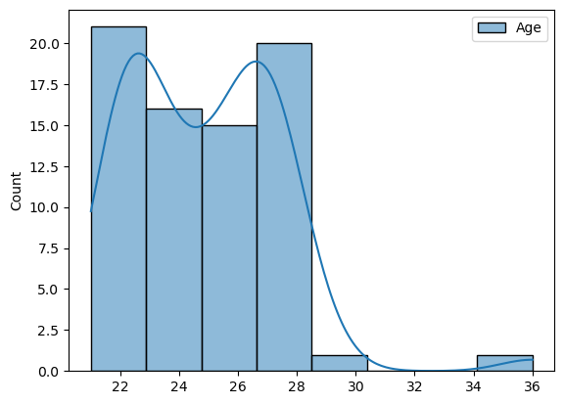
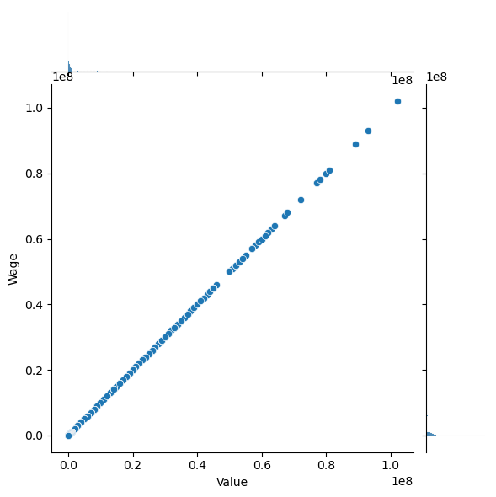
It shows the age distribution with the highest counts around ages 22 and 27, and a noticeable decline in frequency after age 28.
The scatter plot demonstrates a strong positive linear relationship between "Value" and "Wage", indicating that higher values correspond to higher wages.

Slide 10
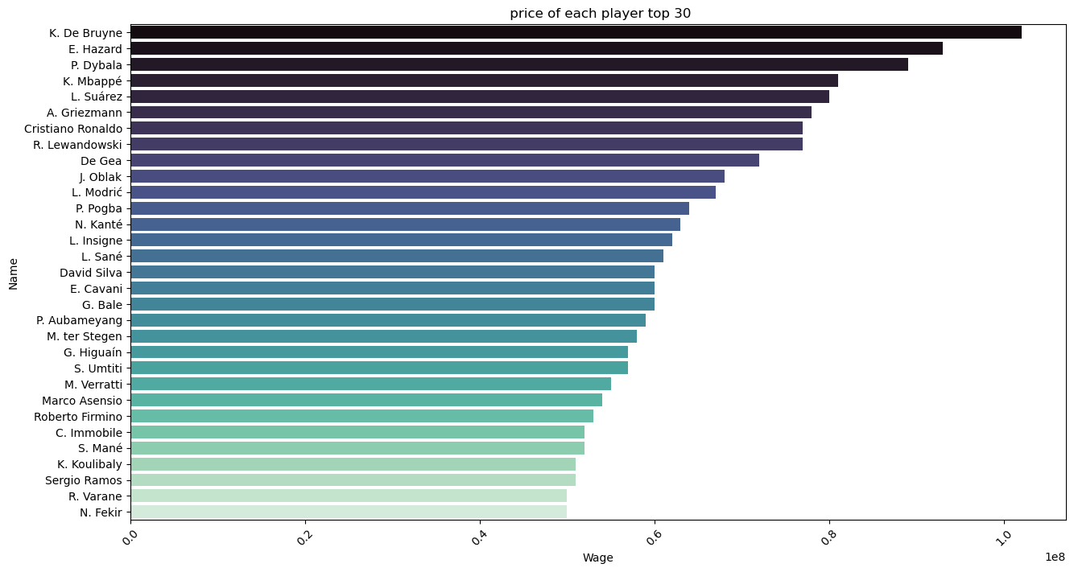
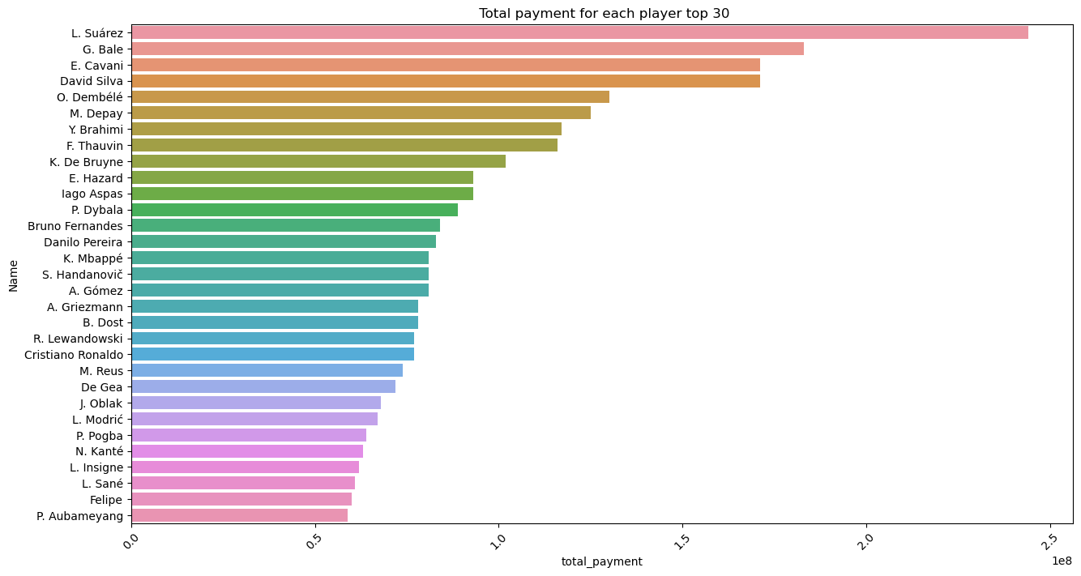
The bar chart displays the wages of the top 30 highest-paid football players, with Kevin De Bruyne earning the highest and Nabil Fekir earning the lowest among them.
The bar chart shows the total payments for the top 30 football players, with Luis Suárez receiving the highest total payment and Pierre-Emerick Aubameyang the lowest among them.

Slide 11
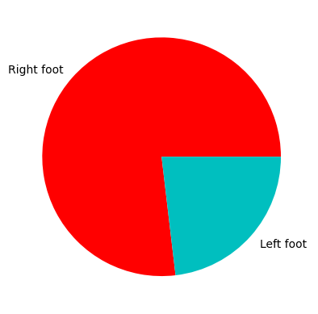
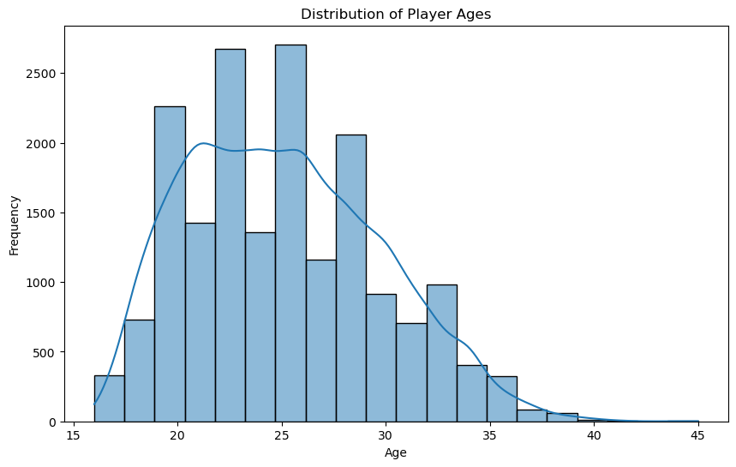
It shows that most of the players are right foot players around 75% are occupying it. Where left foot player are 25%
The histogram shows the distribution of player ages, with a peak frequency around ages 24-26 and a gradual decline towards older ages, extending up to around 40 years.

Slide 12
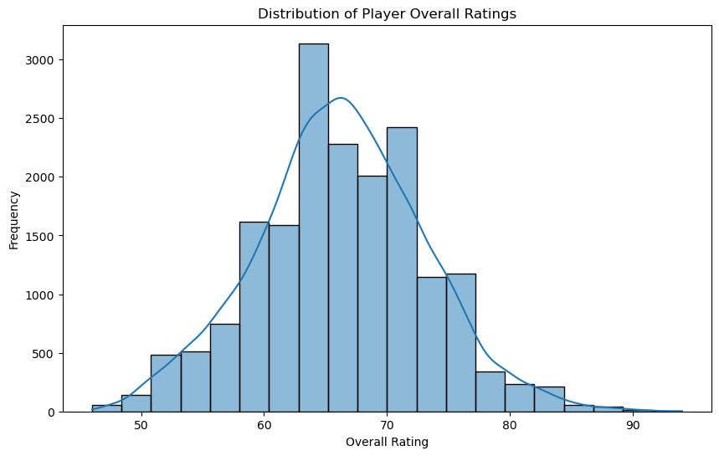
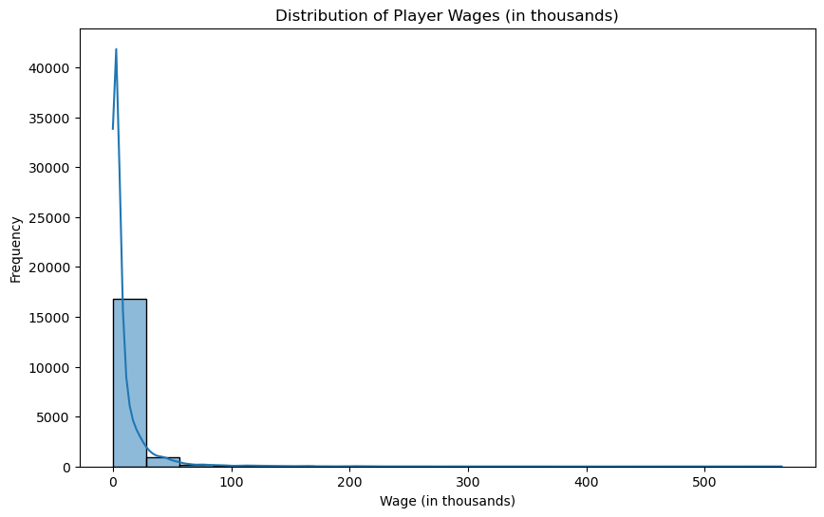
The histogram shows the distribution of player overall ratings, peaking around a rating of 65-70, with a symmetric bell curve and fewer players at both the lower and higher ends of the rating spectrum.
The histogram shows the distribution of player wages, with a significant majority earning below 50 thousand and a long tail extending to higher wages, indicating a highly skewed distribution.

Slide 13
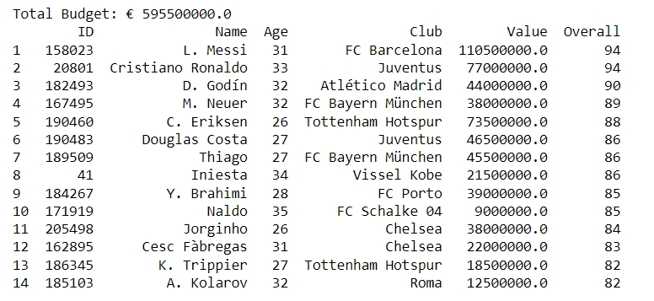
Conclusion :

Slide 14
High-Value Players:
L. Messi and Cristiano Ronaldo are the most valuable players, with values of €110,500,000 and €77,000,000, respectively. They also share the highest overall rating of 94.
Top Clubs Represented:
Players from elite clubs like FC Barcelona, Juventus, Atlético Madrid, FC Bayern München, and Chelsea dominate the list, reflecting these clubs' investment in high-quality players.
Age Distribution:
The players' ages range from 26 to 34, indicating a preference for experienced players who are likely at or near their peak performance levels.
Budget Allocation:
The total budget for all listed players is €595,500,000, suggesting a significant financial investment in top-tier talent. This budget would require substantial resources, indicating these players are part of well-funded teams.
Player Value and Overall Rating Correlation:
There is a general correlation between a player's value and their overall rating, with higher-rated players commanding higher market values. For instance, M. Neuer (Overall 90, Value €38,000,000) and C. Eriksen (Overall 88, Value €73,500,000) are among the more valuable players.

Slide 15


